Slide 1
Optimizing Regional Strategies and Product Offerings for Gardein in the Meat Substitute Market
- Group 8:
Rachana Mahapatra
Venkata Prudhvi Kumar Marpina
Venkata Reddy Malipatel
Sai Anuragh Sangoju
Sai Aakash Srigiri
Sushya Sri Kalyan Teja Adapala
Sri Chaitanya Reddy Kanupuru

Slide 2

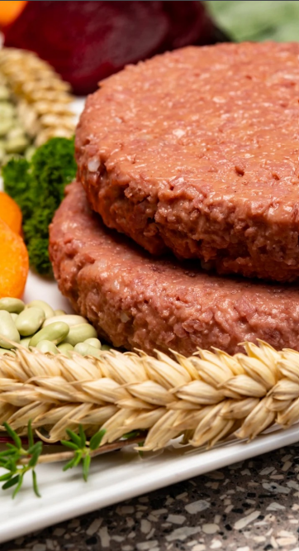

Meat Substitutes and Market Overview
Meat Substitutes are plant-based food product designed to mimic the taste, texture, and nutritional value of traditional meat products.
They have gained significant popularity due to increasing consumer shifts towards plant-based diets, health consciousness, and environmental awareness, with brands like Gardein, Morning Star, and Beyond Meat leading this growing market segment.
The global meat substitutes market size was valued at USD 18.78 billion in 2023 and is expected to grow at a compound annual growth rate (CAGR) of 42.4% from 2024 to 2030

Slide 3


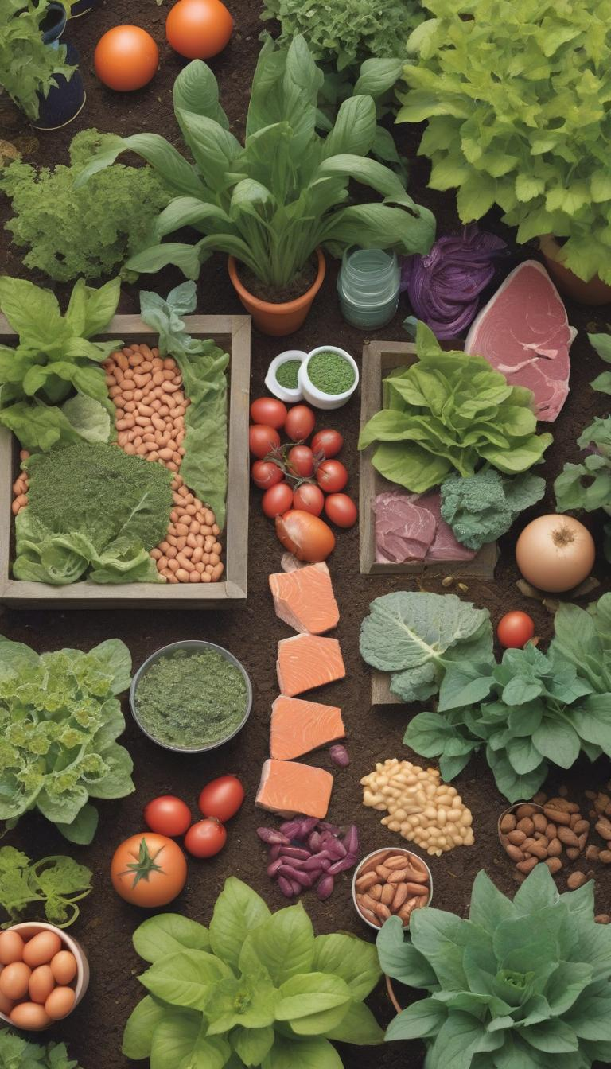

Abstract
The primary objective of this report is to analyze historical sales data to provide strategic insights for Gardein's stakeholders
The analysis specifically focuses on understanding sales patterns and consumer preferences in the meat substitute market, where Gardein shows potential for growth despite it is ranked as one of the top brands in the US.
To address this we will identify region-specific strategies that can be implemented to boost the sales of Conagra’s Gardein brand.
Also, our goal is to understand the consumer preferences seasonally across all the regions in the US.

Slide 4

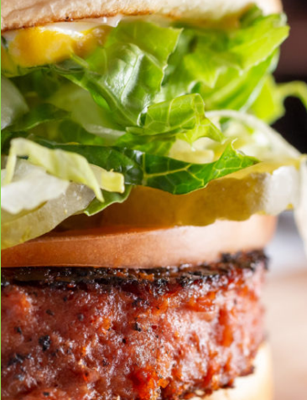
Product Attributes
Type Of Meat Substituted
Total Ounces
Type Of Substitute
Meat Source
Brand Name
Cooked Info
Form
Package
Flavor / Scent

Slide 5

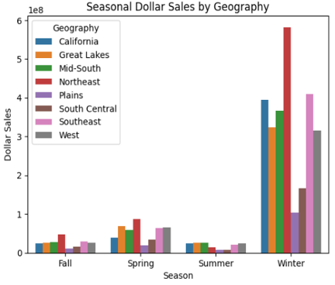
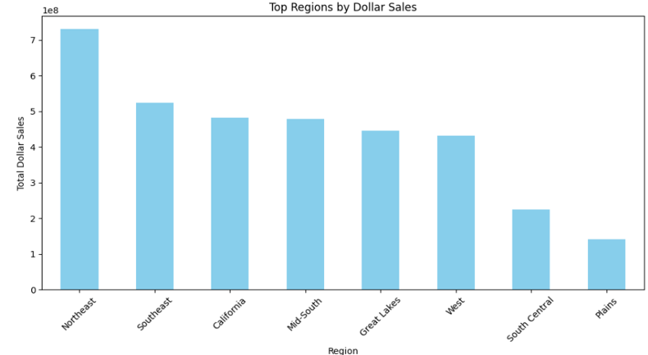
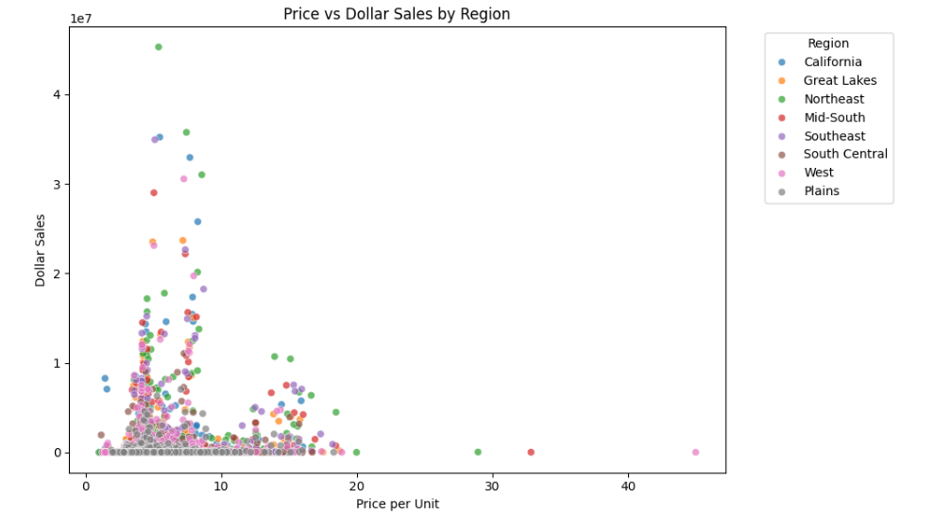
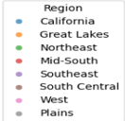
Data Overview
Winter generates peak dollar sales in the Northeast, Southeast, and California regions, while Summer and Spring experience lower sales that require promotional strategies.
The Northeast leads in dollar sales followed by Southeast and California, with Winter showing peak performance, while underperforming regions like Plains and South Central and slower seasons (Summer/Spring) require targeted marketing and promotional strategies to boost sales.
Most sales occur at lower prices (under $10), with some premium-priced products performing well in specific regions

Slide 6
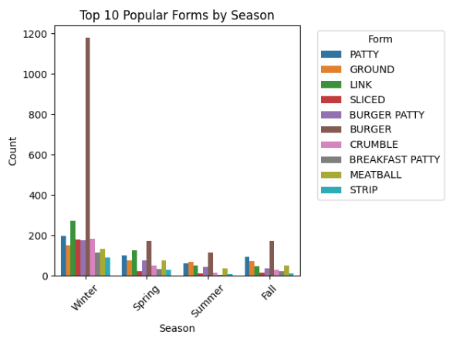
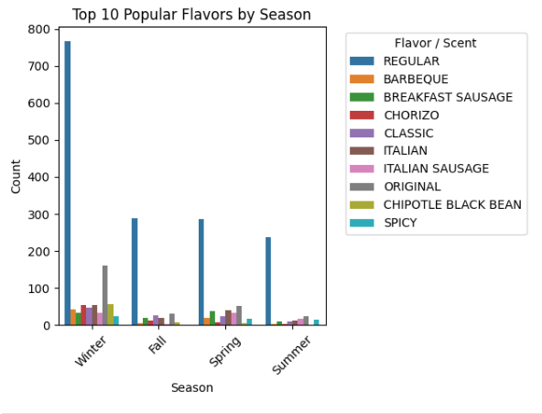
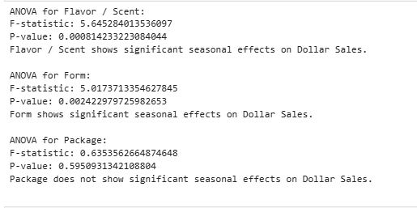
Effect of seasonality on consumer preferences
Consumer preferences on Forms and Flavor change seasonally and the result is significant.
"Burger Patty" performs better in Winter, likely due to its appeal in hearty meals. Other forms like "GROUND," "LINK," and "PATTY" show consistent demand across seasons
"CLASSIC" and "REGULAR" flavors perform best in Winter, showing a preference for comforting flavors in colder months. Other flavors, like "ITALIAN" and "ORIGINAL," have steady demand year-round

Slide 7
Regression Analysis
The regression model predicts how various product attributes, such as flavor, form influence Dollar Sales
Certain flavors and forms show significant seasonal effects. "CLASSIC" and "REGULAR" flavors perform better during Winter "Burger Patty" also sees a boost in sales during the colder months.
The model also indicates that products with higher availability (ACV Weighted Distribution) and higher prices are more likely to generate higher sales.
Overall, this model helps us understand how different product attributes and their interactions with seasons affect sales, providing valuable insights into which attributes to focus on for higher sales and profitability.

Slide 8
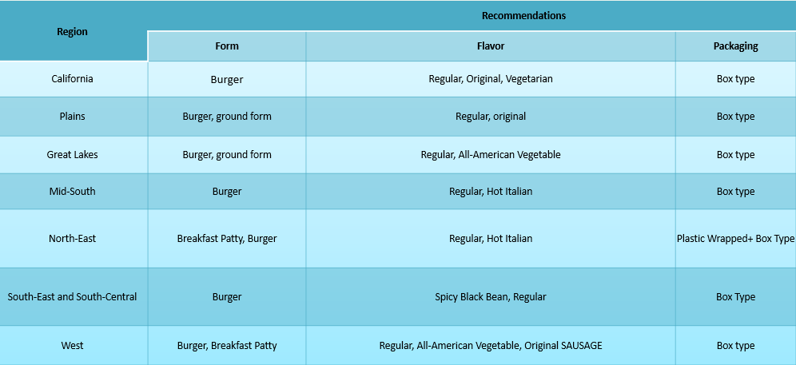
Regional Strategies Clustering Analysis – K means Clustering

Slide 9
Clustering Analysis
1. Focused Data Selection: We specifically analyzed top brands including GARDEIN, selecting only data from the top 10 meat substitute brands for precise market insights.
2. Categorical Encoding and Standardization: For each brand, we first encoded categorical variables such as 'Package', 'Form', 'Flavor / Scent', and 'Geography' to numerical values using a label encoder. We then standardized numerical features like 'Dollar Sales' to prepare for clustering, ensuring each feature contributes equally to the model.
3. Optimal Clustering: Determined the optimal number of clusters = 6 using silhouette analysis, allowing for effective segmentation of each brand's offerings based on consumer preferences and sales data.
4. Regional Strategy Development: The resulting clusters are integrated back into the original dataset, allowing us to develop targeted regional strategies for Gardein and other brands. These strategies are designed to capitalize on regional preferences and popular choices, enhancing market penetration and product positioning in those areas.

Slide 10
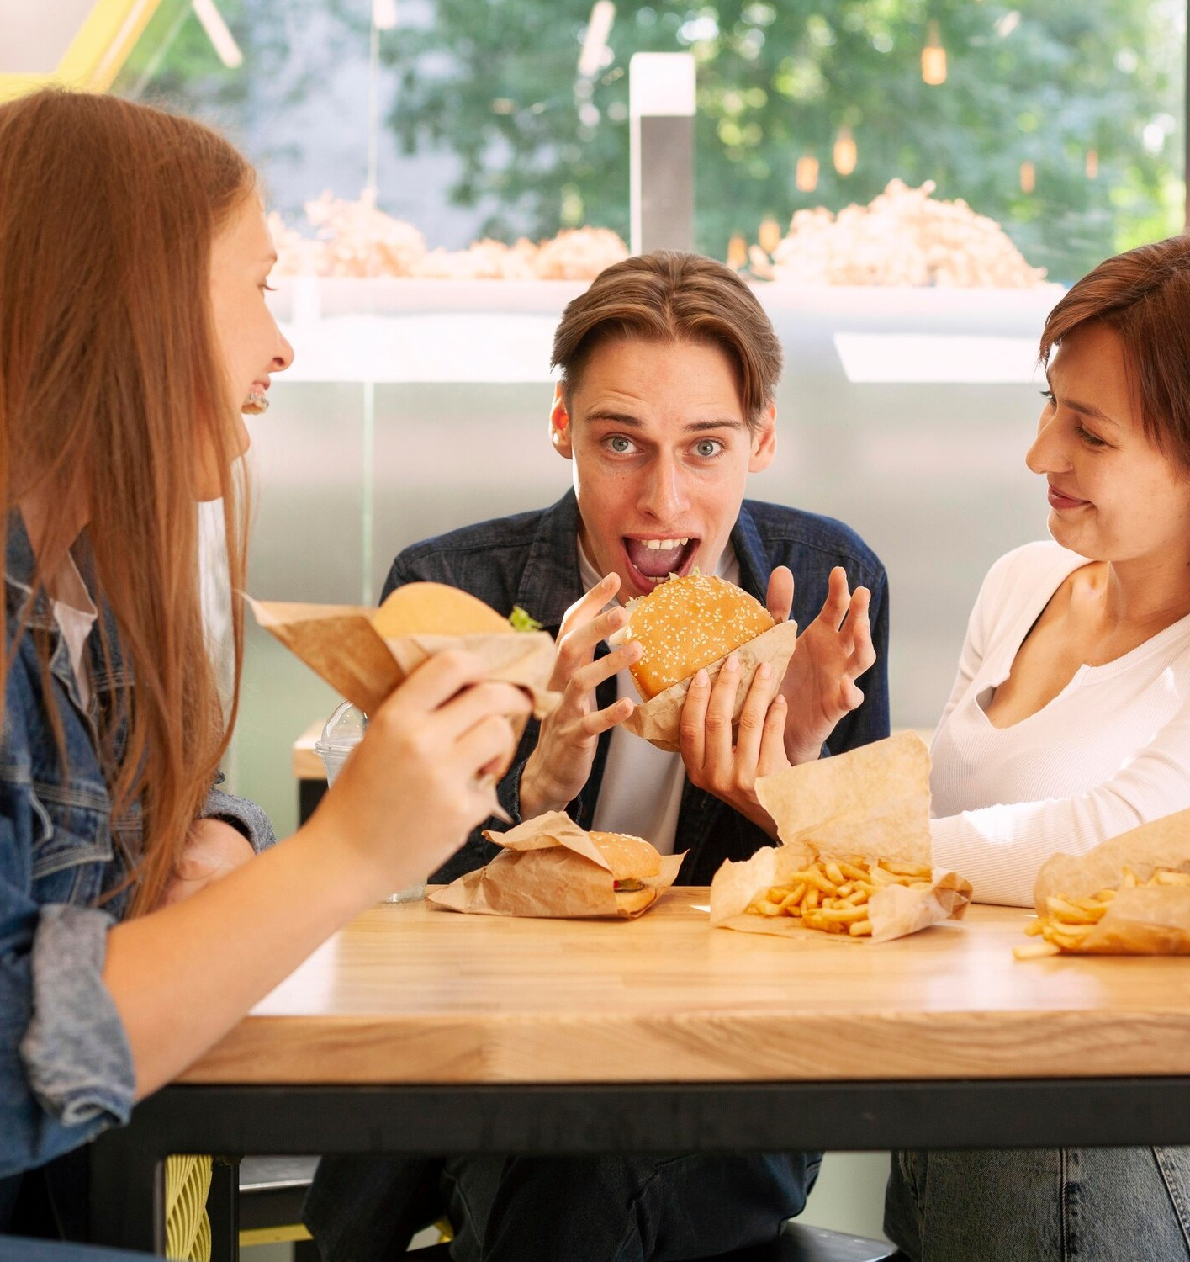
Recommendations
Strengthen Gardein’s presence in the Northeast and California by expanding distribution and marketing for high-performing products like "Burger Patty" and "Hot Italian Ground.
Target underperforming regions, such as the Plains and South Central, to explore untapped potential.
Increase availability of high-potential products, such as Resealable Plastic Bag "Burger" Regular, in key markets.
Collaborate with retailers to enhance shelf visibility and branding for underperforming items.
Phase out consistently underperforming products like Boxed "Burger" Regular to streamline the portfolio.
Promote popular products like "Breakfast Patty" Bacon and "Ground" Regular to drive sales.
Highlight eco-friendly packaging options to attract environmentally conscious consumers.
Focus on premium-priced products in regions like the Northeast, where consumers value quality and sustainability.

Slide 11

Thanks!

